Slide 1

GG PLOT
SUNDEEP RAVICHANDER

Slide 2
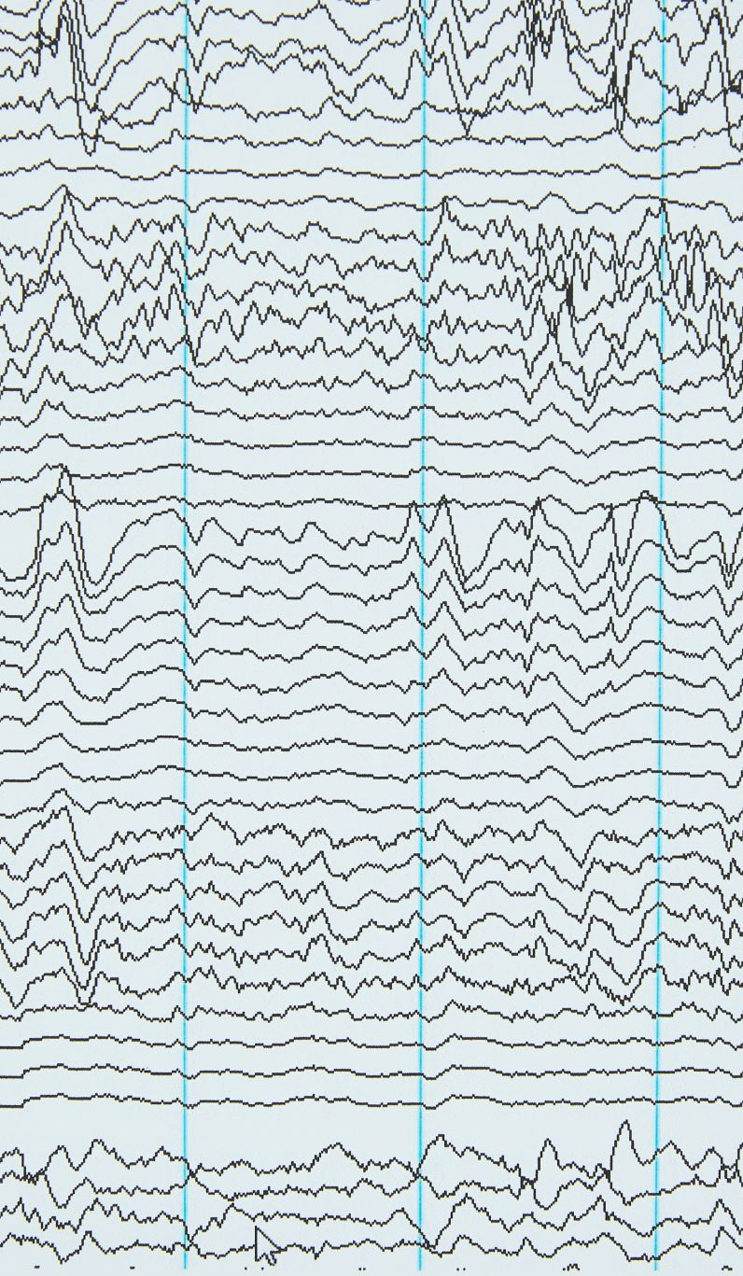
What is ggplot
GGplot is a data visualization system based on the Grammar of Graphics.
Plotnine is the Python implementation of ggplot2 from R.
Each layer adds a new component: data, aesthetics, geoms, stats, scales, coordinates, or facets.

Slide 3
The Grammar of Graphics Explained
Introduced by Leland Wilkinson.
A visualization framework that defines how graphics represent data.
Every visualization can be broken into seven layers:
1. Data
2. Aesthetics
3. Geometric Objects
4. Statistical Transformations
5. Scales
6. Coordinate Systems
7. Facets

Slide 4
Layer 1 – Data
The dataset is the foundation of the visualization.
In Plotnine, data is passed inside the ggplot() function.
Example:
df = pd.read_csv('BostonHousing.csv')
ggplot(df)
Defines the source but no visual output yet.

Slide 5
Layer 2 – Aesthetics (aes)
Aesthetic mappings describe how data variables map to visual properties.
Common aesthetics: x, y, color, size, shape, fill.
Example:
ggplot(df) + aes(x='RM', y='MEDV')
Links average number of rooms to median home value.

Slide 6
Layer 3 – Geometric Objects (geoms)
Geoms define the type of visual mark (point, bar, line, box, etc.).
Each geom layer adds a visual representation.
Examples:
geom_point(): scatterplot
geom_histogram(): histogram
geom_boxplot(): box plot
Multiple geoms can be layered together for richer visuals.

Slide 7
Layers 4 & 5 – Statistical Transformations and Scales
Statistical transformations summarize or compute derived data before plotting.
Example: geom_histogram() uses stat_bin to create bins.
Scales control how data maps to aesthetics.
Example: scale_x_log10() or scale_fill_gradient().
Together, they control the mathematical and visual interpretation of data.

Slide 8
Layer 6 – Coordinate Systems
Coordinate systems define how data points are arranged in space.
Default is Cartesian (x–y) coordinates.
coord_flip(): swaps axes.
coord_polar(): creates circular plots.
Changing coordinates changes how data is projected and compared.

Slide 9
Layer 7 – Facets
Facets split data into multiple panels based on a categorical variable.
Helps compare subgroups side by side.
Example:
facet_wrap('~CHAS') → splits plots by river proximity.
Encourages pattern recognition across categories.

Slide 10
Why Grammar of Graphics Matters
Encourages structured, reusable visualization design.
Separates data representation (what) from styling (how).
Makes plots flexible, layered, and consistent across projects.
Core idea: Build visualizations systematically, not manually.

